Slide 1
NYC Critical Infrastructure Case Study (Finance)
iQ4 Virtual Vault
Notes:
Good Morning Everyone, This is team VV and I’m the team lead AP
The term critical infrastructure is defined by the Department of Homeland Security as the “16 critical infrastructure industries whose assets, systems, and networks, whether physical or virtual, are considered so vital to the United States that their incapacitation or destruction would have a debilitating effect on security, national economic security, national public health or safety, or any combination thereof”
It was revealed that in late March 2021, CNA Financial Corp., one of the largest insurance companies in the United States was victim to a ransomware attack. As a result, the company faced disruptions of their systems and networks. In May 2021, a ransomware attack on Colonial Pipeline halted plant operations for six days. The attack led to a fuel crisis and increased prices in the eastern U.S.
Vance Jr, the global chair of the cyber security practice at Baker McKenzie LLP, and former Manhattan District had a meeting conducted in 2016 in NYPD, where the purpose was to discuss about cybercrime and cyber terrorism prevention strategies generally, by working on ‘what-if’ scenarios. The question was ‘What would happen if a terrorist or state actor attacked one of the 16 critical infrastructure, and who would respond’

Slide 2
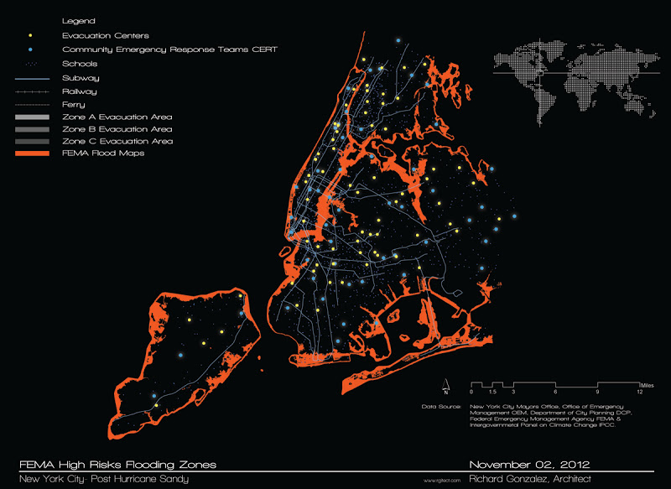
Steps Taken :
Representatives convened to fix the communication gap for each critical infrastructure.
Creation of task force teams.
Responsible for sharing real-time intelligence.
Responsible for training to respond by table exercises.
Responsible for convening at an operations centre in case of an attack.
Notes:
Models were looked elsewhere for guidance, but there were none that met the extraordinary needs of the moment. It would be the responsibility as a New York City community to manage that attack, mitigate it and restore city operations.
The meeting concluded with the creation of the CCSI Project.
It was decided that representatives of the 16 critical sectors would be convened in New York City at a meeting to discuss and fix this gap. A public/private partnership was created with a task force of members from each critical sector to do three things; one, to share real-time cyber threat intelligence through the NYPD intelligence bureau to the private sector partners and other government agencies; two, to train for responding to potential attacks together by doing table exercises at the IBM cyber range in Boston; and three, in the event of a real attack, to convene at an operations center (which was opened in June 2021) to manage the attack from a secure location with access to power and communications even when there was a loss of power or communications outside the center. In the years since its inception, the task force has been a key intelligence-sharing hub for New York City and unlike other parts of the country, New York City’s critical infrastructure, remarkably, has been relatively unscathed by any significant cyber attack.

Slide 3
Vulnerability Factors
The Need for combating the CyberThreats to the Critical Infrastructures…
Notes:
The need for combating cyberthreats to critical infrastructure is well recognized. However, the infrastructure today is far from secure. This is due to a many interrelated factors that create a perfect storm of exposures.
First, many of our most critical systems are extremely complex. This complexity is rapidly increasing as the number of devices and connections in these systems continues to grow.
Second, many of these systems involve a mix of insecure, outdated legacy systems and new technologies. These new technologies promise features like advanced analytics and automation. However, they are sometimes connected and used in insecure ways that the original designers of the legacy systems could not have imagined.
Taken together, these factors mean that these systems are too complex to be completely understood by a person, a team of people or even a computer model. This makes it very difficult to identify weak spots that if exploited — accidentally or intentionally — could lead to system failures.

Slide 4
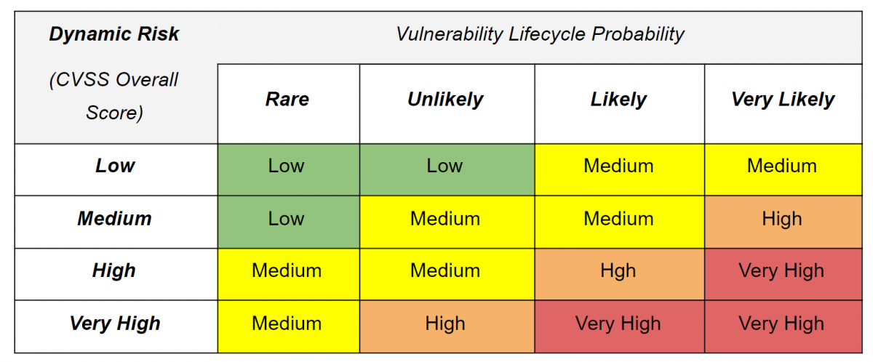
Risk Assessment and Prevention
Through Internet-of-Things
Through Dark Web
Through Encryption
Through Cryptocurrency
Through Social Media
Notes:
We will be assessing the risks based on a High, Medium, and Low Scale.
High is the threat source is highly motivated and sufficiently capable and controls to prevent the vulnerability from being exercised are ineffective
Medium is The threat source is motivated and capable, but controls are in place that may impede successful exercise of the vulnerability
And Low is the threat source lacks motivation or capability, or controls are in place to prevent or significantly impede exercising the vulnerability

Slide 5

Preventing exploitation by: IoT
Standardization
Consider Zero Trust
Discover IoT devices on the network
Patch printers and other easily patchable devices
Avoid Bluetooth devices like keyboards
Segment IoT devices across VLANs
Expand security to all IoT devices through product integration
Notes:
When financial and personal information is being transmitted through the IoT network, the data can be breached and
hacked. This is a High Risk on the scale.
Different devices require different maintenance approaches. There are no common standards for maintaining IoT.
The matter is that all hardware used in IoT can be manufactured by different suppliers and they cannot have one common maintenance standard. And even if all hardware manufacturers in the world will agree to use one specific standard, technical issues will remain. Only if there will be one monopolistic manufacturer of all equipment, but it is unreal since it will damage economic situation in the whole world. So, the lack of common standards can be the reason for failures in the functionality of IoT devices. According to the 2020 Unit 42 IoT Threat Report, Standardization should be implied which is the process of creating a more uniform, consistent IT environment by limiting the number of systems, devices, applications, services and configurations.

Slide 6
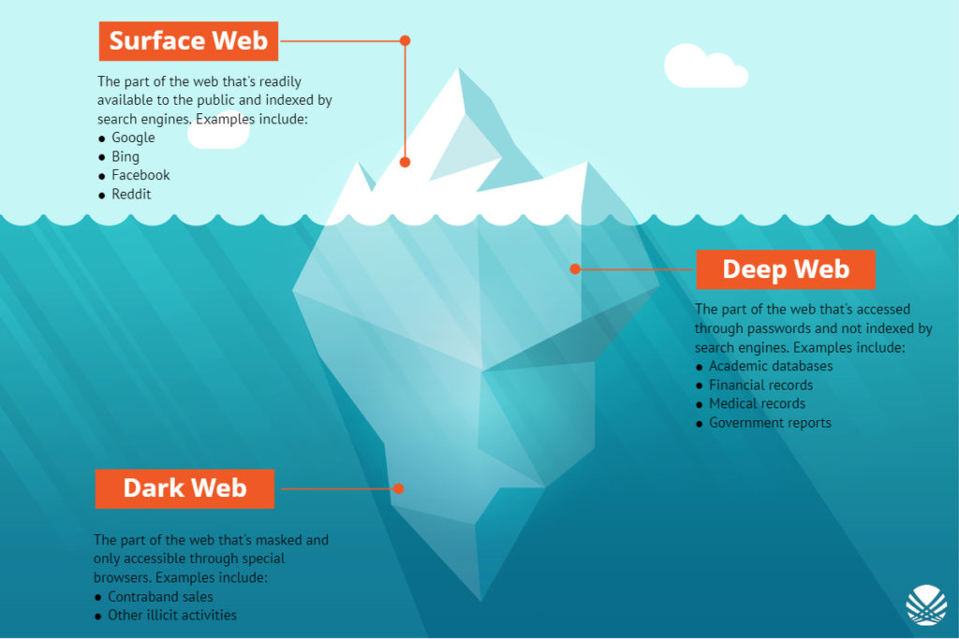
Preventing exploitation by: Dark Web
1318% increase in cyber risk in the finance industry
Ransomware, BEC, CryptoJacking, Zero Day Exploits
Exploitation of breached data
Cloud Service Attacks
Notes:
This is Low Risk on Scale.
0-day vulnerability attacks have emerged as one of the major cybersecurity concerns in the last few years. It is known to target individuals, large enterprises, government agencies, and for that matter, any organization irrespective of its size or nature of the industry. According to data released by the Google Project Zero security team, they detected 20 zero-day vulnerability attacks in 2019 and 11 zero-days in the first half of 2020 in the wild. Once hackers have successfully identified a zero-day vulnerability, they try to leverage it to carry out attacks on a system, which is known as a zero-day exploit.
With a year-over-year increase of 1,318%, cyber risk in the banking sector has never been higher. In 2021, ransomware comprises the majority of cyber attacks on the banking industry. According to a report published by the US Treasury’s Financial Crimes Enforcement Network (FinCen), the 635 suspicious activity reports (SARs) filed in the first half of 2021 represent a 30% increase over the entirety of 2020.
Measures use to prevent exploits
All businesses that process online credit card transactions should comply with the Payment Card Industry-Data Security Standard (PCI-DSS). PCI-DSS includes a set of twelve requirements to secure credit card data and other personal information related to online transactions.
We’re seeing major banks put AI technology into practice that approaches fraud detection from a forward-thinking perspective rather than waiting until after fraud occurs to act.

Slide 7
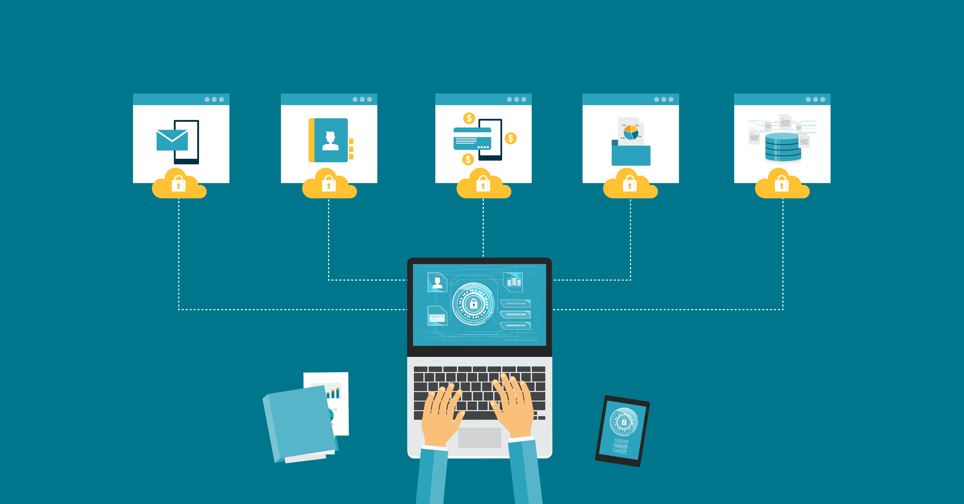
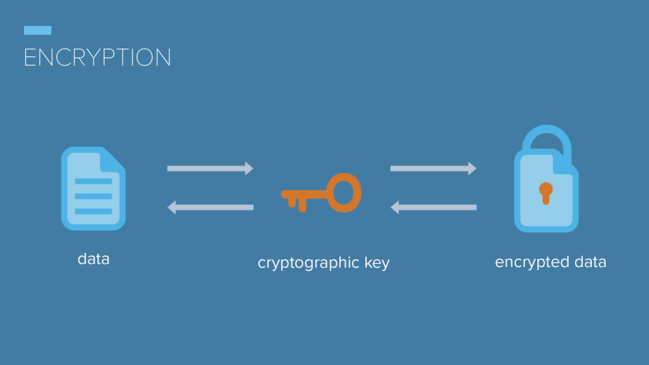
Preventing exploitation by: Encryption
Lawful access to encrypted devices
Law enforcement access encrypted content
Accessing mobile device communications, emails, and other encrypted forms of suspected data
Notes:
Even though this is low risk on the scale By regularly monitoring the Dark Web, security professionals can gain valuable insights into emerging trends and specific threat intelligence to improve their defensive techniques. They can leverage chatter on Dark Web forums as an early warning system, alerting them to new bots, viruses or malware that have appeared on the scene. Monitoring the Dark Web can provide early notification of an attack on a specific organization(s) too. Chatter on the Dark Web mentioning some form of access or the sale of credentials, names of executives and other information that is specific to an organization can be a giveaway you’re under attack or are being highly targeted.
At least 2,000 law enforcement agencies in all 50 states of the U.S. now have access to tools that allow them to get into locked or encrypted smartphones and extract data from it. There’s widespread use of mobile device forensic tools (MDFTs) by more than 2,000 law enforcement agencies. These forensic tools allow police to extract a full copy of data from a phone including emails, texts, photos, location, app data, and more, which can then be programmatically searched.

Slide 8
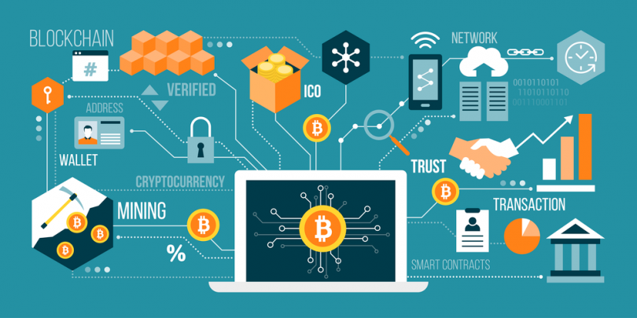
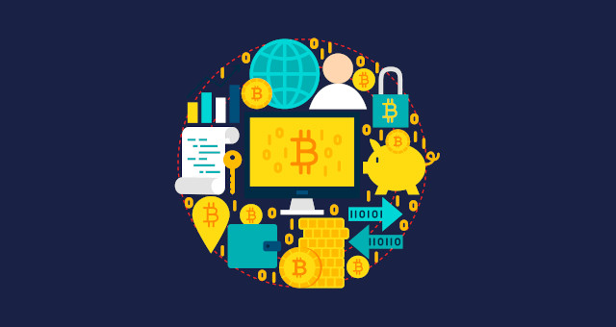
Preventing exploitation by: Cryptocurrency
Complex protocol implemetation
Improving Cryptocurrency Trading platform
Ransomware attacks
Attack on the device used by user to get keys
Notes:
Blockchain is a new technology. This means that it becomes hard to include blockchain protocols into a project. According to Deloitte, it is hard to implement different blockchain projects. For example, if they want to share information from Hyperledger Fabric Protocol to Ethereum Protocol, they would need an integration layer that manages these two different enterprise systems
Cybercriminals can hack into cryptocurrency trading platforms and steal funds. Cryptocurrency is already the most preferred form of exchange in cases of ransomware attacks. We consider this a Medium Risk on the Scale.
Cybercriminals can hide their true identities when asking for ransom in digital currencies. When making an exchange, they can easily convert cryptocurrencies into traditional forms without ever being discovered. They can attack any business and ask for ransom in digital currencies since this form of cybercrime is practically untraceable with no evidence linked to the criminal.
Hackers know that the entire blockchain technology relies on the public and private keys, and they also know that it is a waste of time in guessing those keys. That’s why they try to get the keys by attacking the weakest point, i.e., the system that is used by the user. It can be a mobile device or a personal computer.
In any of the case, the hacker can take advantage of the vulnerabilities shown by these devices. If you are using Android, they will simply try to install malware to get access to the information that you share through your device. If you input your private key, they can make a copy of it, and send it to their own computers. With the private key in hand, they can then access the information stored. Most of the time, it’s the user’s fault for not securing their systems.

Slide 9
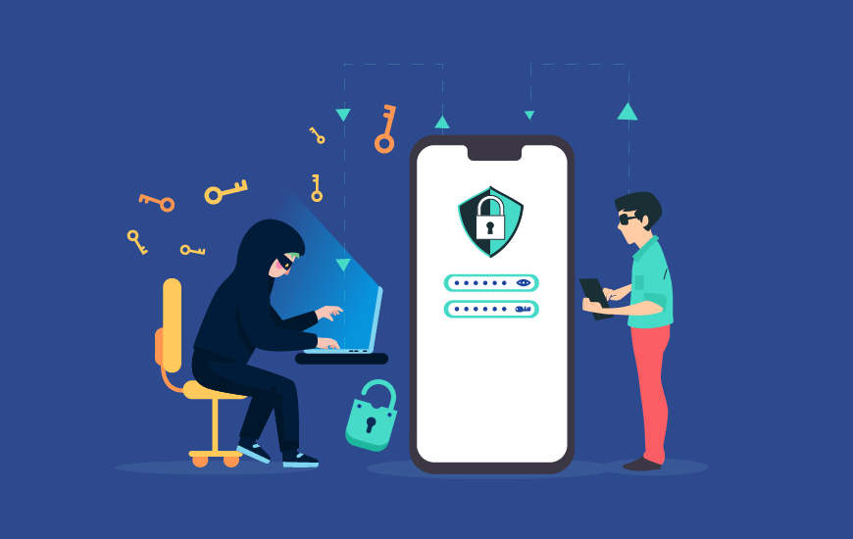
Preventing exploitation by: Social Media
Used by Cybercrime groups
Threat actor reconnaissance and actions on the objectives
Malware command and control (C2)
Exfiltration
Notes:
Exploitation of social media can be considered a high risk ono the scale since there is comparatively least control over it’s content and the maximum damage cn be induced.
Social Media can also be used by malware to receive command and control instructions, download additional payloads or can be used as a destination for exfiltrated data. This activity can happen in plain sight as most companies/orgs allow social media use for their employees and security teams don’t have the capacity/capability to monitor them for signs of maliciousness. Cybersecurity focused individuals/teams/organizations can use social media to monitor for announcements of new vulnerabilities, malware campaigns and threat actors who may be targeting organizations and industry verticals. This allows cybersecurity teams to generally stay on top of emerging threats, but is typically reactive not proactive!
The best way to stay on top is by maintaining the following aspects:
Performing data discovery.
Controlling access to sensitive data
Using Principal of Least Privilege
Encrypting the data
Installing anti-malware software
Performing vulnerability assessment and audits.
Having a data usage policy
Creating and implementing employee security and training
Physically safeguarding data
Creating strong passwords
Enabling 2 factor authentication
Complying with security regulations
Investing in secure cloud services.
Eliminating data after it is no longer needed
Monitoring third-party access to data
Using VPNs and not using public WiFi
Pseudonymization – which is a method recommended by the GDPR, which is the removal of identifying information from snippets of data, and replacing it with randomly generated “strings”.
Not using same password for multiple accounts

Slide 10
Sources
New York Launches a Cybercrime Brigade – WSJ
A three-step path to securing critical infrastructure | World Economic Forum
NYC Cyber Critical Services and Infrastructure (CCSI) Project

Slide 11
Thank You !

